Slide 1
California Weather & Wildfires
Breanna Sewell

Slide 2


Project Motivation & Summary
This analysis aims to determine if there are correlations between meteorological factors and wildfire extent or duration within California over the span of 8 years
Wildfire variables analyzed:
Wildfire extent – acres burned
Wildfire duration – number of days fire lasted
Weather variables analyzed:
DX90 – number of days over 90˚F
HX01 – extreme maximum soil temperature (˚F)
EMXP – extreme maximum daily precipitation (in.)
EMXT – extreme maximum daily temperature (˚F)
PRCP – total annual precipitation (in.)
WSFG – peak wind gust speed (mph)
WSF2 – maximum 2 min gust speed (mph)
TAVG – average annual temperature (˚F)
TMAX – average annual maximum temperature (˚F)
My findings suggest there is little to no correlation between any of the weather variables and wildfire variables, at least at the scale with which the analysis was conducted

Slide 3

DATA Sources
Wildfire Data
2013-2020 California wildfires – name, coordinates, start time/date, end time/date, acres, duration
Source: California Department of Forestry and Fire Protection (CAL FIRE)
Weather Data
2013-2020 California weather station records – station, coordinates, year, DX90, HX01, EMXP, EMXT, PRCP, WSFG, WSF2, TAVG, TMAX
Source: National Oceanic and Atmospheric Administration (NOAA)

Slide 4
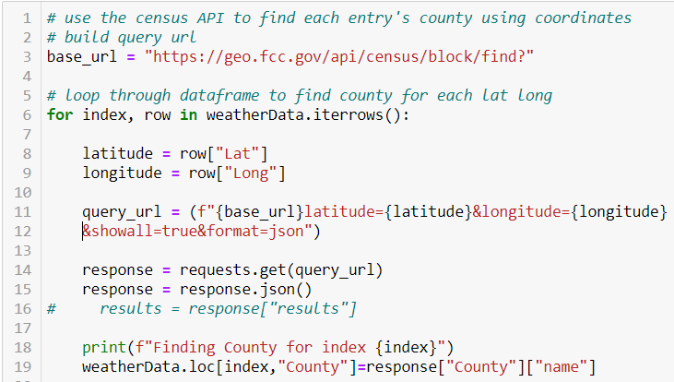

Cleaning

Slide 5
Data Cleaning
Cleaned wildfire and weather data separately using pandas in Jupyter Notebook
Only common variable between the datasets was coordinates… which was too difficult to merge on
Used the Federal Communications Commission (FCC) census API to look up county using coordinates for each row of weather data (5,000+ rows)

Slide 6
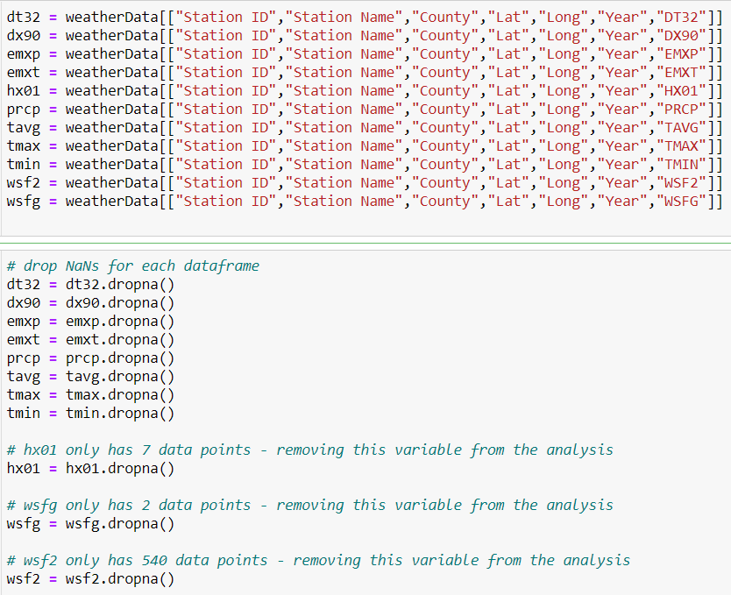
Data Cleaning
Had to break weather variables into separate data frames before dropping nulls in order to preserve as much data as possible
After dropping nulls, 3 of the weather variables had insufficient records for analysis and were removed
HX01
WSFG
WSF2

Slide 7
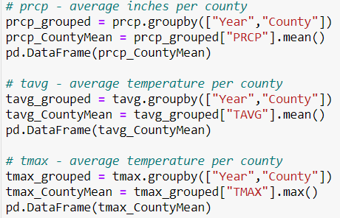
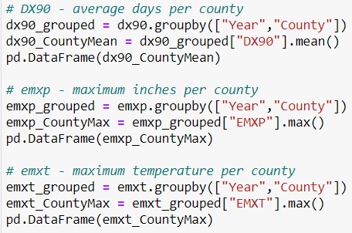
Data Cleaning
Each weather variable’s data frame was then grouped by year and county and aggregated using the most appropriate function (mean or max)
Each data frame was then exported to csv

Slide 8
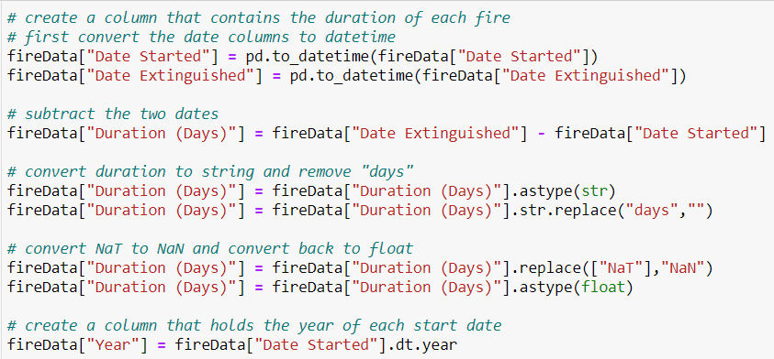
Data Cleaning
To get the duration of each wildfire, the date started and date extinguished were converted to ‘datetime’
The date started column was subtracted from the date extinguished column to get duration in days
Year of start date was extracted to its own column

Slide 9
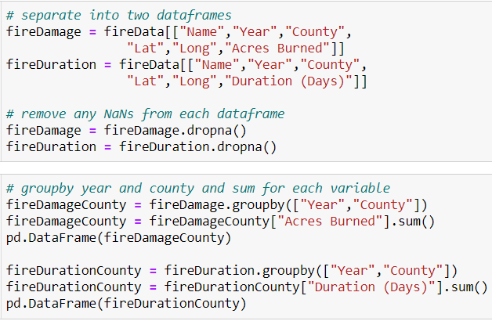
Data Cleaning
All NaT’s were converted to NaNs
Like the weather data, the two wildfire variables were broken into separate data frames before the nulls were dropped in order to preserve data
Each wildfire variable’s data frame was then grouped by year and county and aggregated by sum
Each data frame was then exported to csv

Slide 10
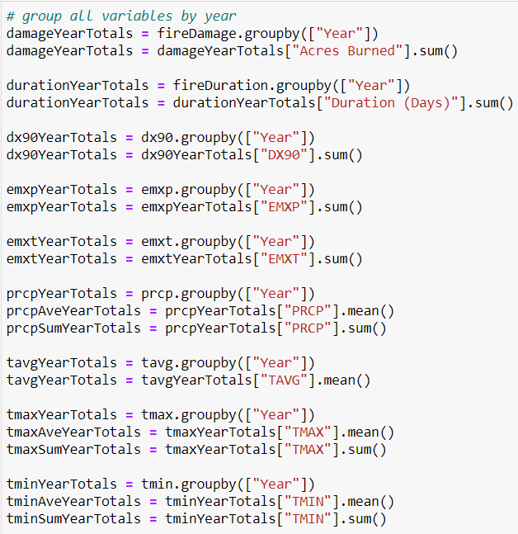

Analysis

Slide 11
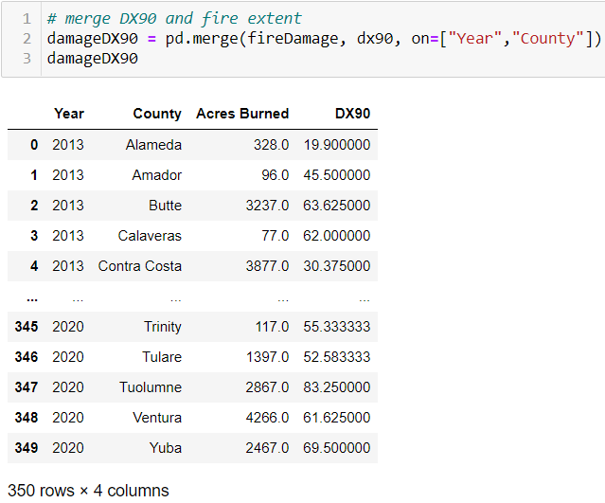
Data Analysis
The intent was to assess correlation between each wildfire variable and each weather variable at the county level
After merging the first two data frames, wildfire extent and DX90, many rows dropped
This was because many fires span multiple counties, which hadn’t occurred to me previously
This is problematic not only because of the loss of data, but because of the type of data lost – generally speaking, fires that span multiple counties are the largest fires – which are critical data points

Slide 12
Data Analysis
Instead, the analysis had to be done at a higher level
Each of the data frames (both weather and wildfire variables) were grouped by year and aggregated using the most appropriate function per variable (e.g., sum, mean, max)
Some weather variables were aggregated using multiple functions

Slide 13
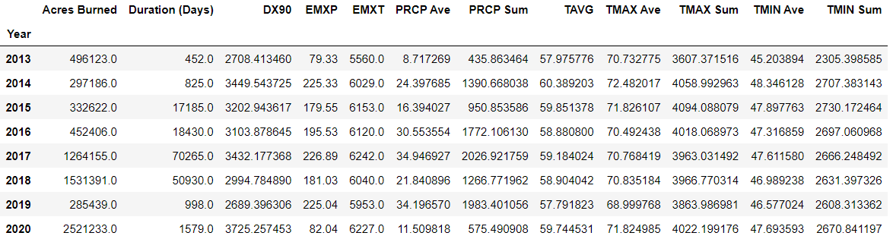
Data Analysis
The variables were then added back to a common data frame
Each combination of variables was plotted on a scatterplot and the r-value was calculated

Slide 14
Results

Slide 15
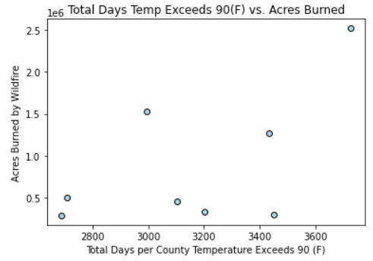
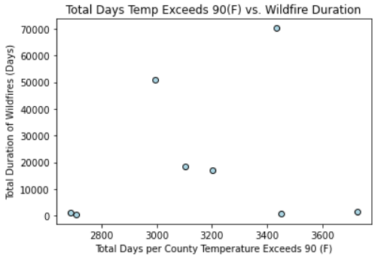
Results: DX90
DX90 vs. Fire Extent
r-value: 0.58, moderate correlation
DX90 vs. Fire Duration
r-value: 0.15, no correlation

Slide 16
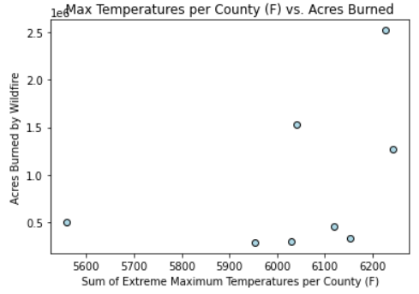
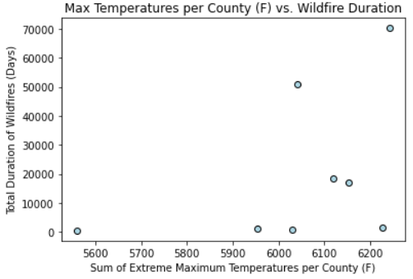
Results: EMXT
EMXT vs. Fire Extent
r-value: 0.43, weak correlation
EMXT vs. Fire Duration
r-value: 0.43, weak correlation

Slide 17
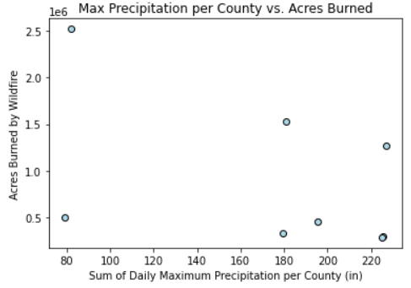
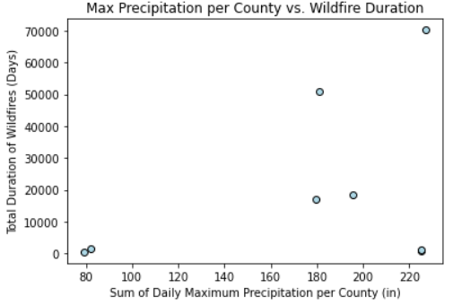
Results: EMXP
EMXP vs. Fire Extent
r-value: -0.47, weak correlation
EMXP vs. Fire Duration
r-value: 0.39, weak correlation

Slide 18
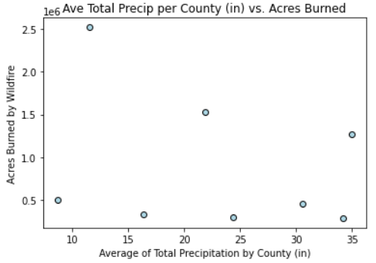
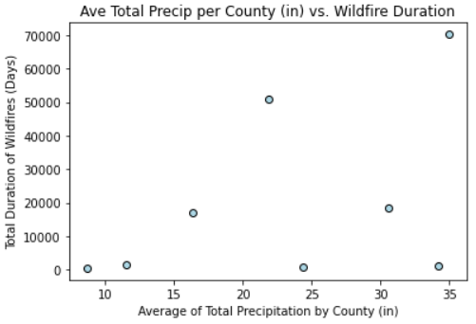
Results: PRCP
PRCP vs. Fire Extent
r-value: -0.29, very weak correlation
PRCP vs. Fire Duration
r-value: 0.44, weak correlation

Slide 19
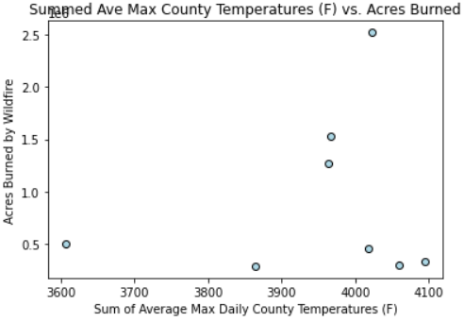
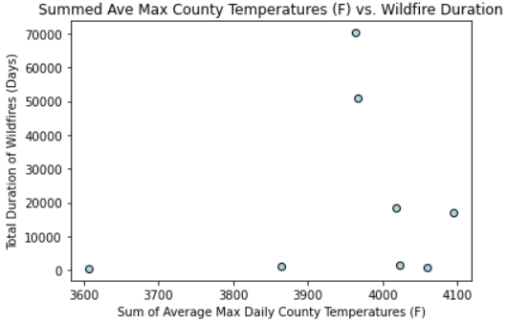
Results: TMAX
TMAX vs. Fire Extent
r-value: 0.17, no correlation
TMAX vs. Fire Duration
r-value: 0.19, no correlation

Slide 20
Discussion
The results were not what I expected – I anticipated stronger correlations
Potential Improvements:
Improved granularity of data – wildfire damage and duration at the county or city level versus at the state level
Visual data – heat map showing relationship between weather and fire
Additional statistical tests and manipulation of data
Additional years of data – ideally back to 1990

Slide 21

Questions

